Slide 1

Popular Fiction: Genres, & Politics
Sonal Jha, PhD
Department of Humanities and Social Sciences
IIT Roorkee

Slide 2
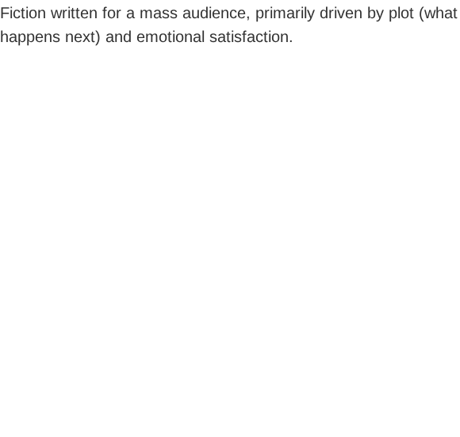

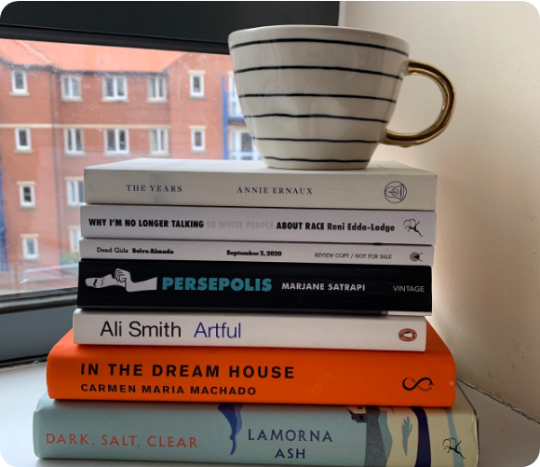
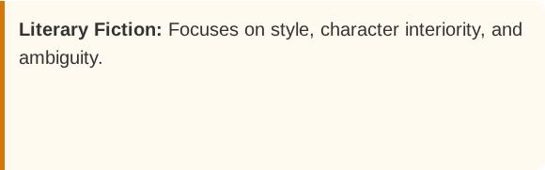
What is popular fiction?
Popular Fiction: Focuses on narrative momentum, tropes, and closure.
• It promises a specific emotional experience – fear in horror, justice in crime, or love in romance.
• It is not just "escapism"; it is a communal experience that reflects the anxieties and dreams of the general public.
• Not merely a ‘guilty pleasure’ but also a powerful cultural tool.
• It is also known as genre fiction.

Slide 3

What is genre?
• It refers to categories such as horror, romance, science fiction etc. into which popular fiction is slotted. For example, Dune is science fiction.
• Novels can fall into overlapping genres as well. For example, the Twilight novels can be classified as both romance and fantasy.
• Every genre represents a "contract" between writer and reader based on pre-set expectations.
• Tropes and character types are used to drive forward the plot. For example, a superhero comic has The Superhero, The Villain, The Sidekick, The Love Interest etc.

Slide 4
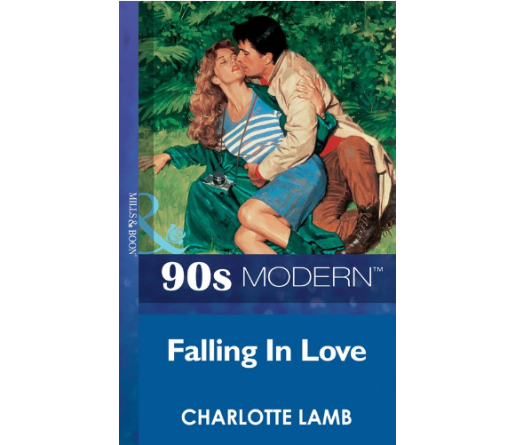
The politics of popular fiction
• Popular fiction as ‘just entertainment’ is a myth. Every work represents the norms and values of its time.
• For example, romance novels have traditionally shaped our ideas of love, masculinity and femininity.
• How does this shape beauty standards and gender roles?
• Who or what gets excluded from these narratives is also noteworthy. E.g. traditionally, all romance fiction focused on heterosexual, white/western couples.
• The popularity of Mills and Boon novels in India – what is the implication of young Indians developing an understanding of love through these books?

Slide 5




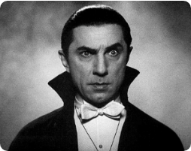
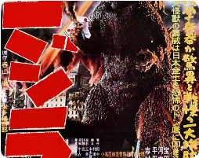
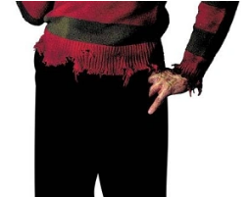
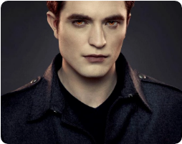
An example: ‘The Monster’
Invader (19th c.)
Mutant (1950s)
Punisher (1980s)
Tragic Figure (2000s)
Dracula: Fear of the foreigner/ the ‘other’ in the context of British colonialism. Fear of foreign contagion (through blood) – racism and xenophobia.
Godzilla: Fear of failure of science in the context of world war II and the atomic bomb.
Freddy Kruger: Fear of loss of traditional values with increasing sexual permissively in the context of the Regan era.
Twilight, Dracula (2025): Fear of loneliness and difference in the context of increasing alienation in modern society.

